Slide 1

Swami Keshvanand Institute of Technology,
Management & Gramothan, Jaipur
2nd Inning (Games & Apps for the Elderly)
Team : AchillesWithoutHeel
Project Members :-
Faculty Mentor & Lab Coordinator :-
Geetam 20ESKIT037
Kunal Sharma 20ESKIT055
Kashish Gupta 20ESKIT053
Ms. Sanju Chaudhary

Slide 2
Objectives
To provide engaging activities that stimulate cognitive function and mental well-being.
Goal: Assist elderly individuals in maintaining mental sharpness, memory, and overall cognitive health.
Importance & Relevance
Aging is often accompanied by cognitive decline, affecting memory, reasoning, and decision-making abilities.
Engagement in mentally stimulating activities has been shown to slow cognitive decline and promote brain health.
2nd Inning aims to fill a crucial gap by offering accessible and enjoyable cognitive exercises tailored to elderly individuals.

Slide 3
Problem Statement
Cognitive Decline in Aging Population: With advancing age, individuals often experience a decline in cognitive abilities, including memory, reasoning, and attention.
Impact on Quality of Life: Cognitive decline can significantly affect daily functioning, independence, and overall quality of life for elderly individuals.
Need for Effective Solutions: There is a growing need for accessible and effective interventions to support cognitive health and well-being in the aging population.

Slide 4
Why It Is Important to Solve This Problem?
Preservation of Independence: Maintaining cognitive function is crucial for preserving independence and autonomy in daily activities.
Enhanced Quality of Life: Addressing cognitive decline can lead to improved mental well-being, increased engagement, and a higher quality of life for elderly individuals.
Reduced Healthcare Costs: By promoting cognitive health and delaying cognitive decline, effective interventions can potentially reduce healthcare costs associated with age-related cognitive impairments.

Slide 5
Literature review
Summary of Related Work & Research in This Field :
Cognitive Aging Research: Extensive research has been conducted on cognitive aging, exploring factors influencing cognitive decline and strategies to mitigate its effects.
Interventions for Cognitive Health: Various interventions, including cognitive training, physical exercise, and social engagement, have been investigated for their potential to preserve cognitive function in aging populations.
Digital Cognitive Interventions: Recent studies have explored the effectiveness of digital platforms and games in improving cognitive outcomes among older adults.
Existing Solutions or Approaches Explored :
Cognitive Training Programs: Structured programs involving memory exercises, problem-solving tasks, and attentional training have shown promise in improving cognitive function.
Physical Activity: Regular physical activity, such as aerobic exercise and strength training, has been associated with better cognitive outcomes and reduced risk of cognitive decline.

Slide 6
Identified Gaps in Existing Literature:
Accessibility: Many existing interventions may not be easily accessible to all older adults, particularly those with mobility issues or limited access to resources.
Personalization: Tailoring interventions to individual needs and preferences is an area that requires further exploration to optimize effectiveness and engagement.
Long-Term Maintenance: Sustaining cognitive benefits over the long term remains a challenge, highlighting the need for ongoing support and follow-up.
How This Project Aims to Address Identified Gaps?
Accessibility: 2nd Inning aims to provide a convenient and accessible platform for older adults to engage in enjoyable cognitive activities from the comfort of their homes.
Personalization: The platform will offer a variety of games and exercises, allowing users to choose activities that align with their interests and cognitive goals.
.

Slide 7
Proposed solution
Methodology:
2nd Inning Platform: An interactive online platform designed to rejuvenate cognitive abilities in elderly individuals through engaging mind games and activities.
User-Centric Approach: Tailored to the needs and preferences of older adults, the platform offers a diverse range of cognitive exercises to promote mental stimulation and well-being.
How Does Your Approach Differ from Existing Solutions?
Accessibility and Convenience: 2nd Inning prioritizes accessibility by offering an easy-to-use online platform that can be accessed from any internet-enabled device.
Engagement and Enjoyment: Unlike traditional cognitive training programs, 2nd Inning focuses on providing enjoyable and interactive gaming experiences to promote sustained engagement and motivation.

Slide 8
Technical Details of the Solution Architecture
Web-Based Platform: 2nd Inning is built as a web-based application, leveraging HTML, CSS, and JavaScript for the Hola, Arcade, and Contact pages, ensuring cross-platform compatibility and ease of access.
MERN Stack for Key Features: Utilizes the MERN (MongoDB, Express.js, React.js, Node.js) stack for critical functionalities such as Buy Request, Login, Register, New Game Posting, and Admin/Player Dashboards, ensuring robustness, scalability, and real-time interaction.
React and Firebase for Add and Review: Incorporates React.js and Firebase for the Add and Review features, providing a seamless and responsive user experience for interacting with game reviews.
MongoDB for Database Related Works: Implements MongoDB as the primary database solution, offering flexibility, scalability, and efficient storage for managing user data and game information.

Slide 9
Implementation details
Overview of Implementation Process:
Agile Development Methodology: 2nd Inning's implementation followed an agile approach, allowing for iterative development and continuous feedback from stakeholders.
Collaborative Team Effort: The implementation involved collaboration among developers, designers, and domain experts to ensure alignment with project objectives and user needs.
Continuous Testing and Iteration: Regular testing and iteration were conducted throughout the development process to address issues and refine features based on user feedback.

Slide 10
Tech Tools and Frameworks Used:
HTML, CSS, and JavaScript: Used for frontend development, including the Hola, Arcade, and Contact pages, to create interactive and visually appealing user interfaces.
MERN Stack: Leveraged the MongoDB, Express.js, React.js, and Node.js stack for key features such as Buy Request, Login, Register, New Game Posting, and Admin/Player Dashboards, ensuring a robust and scalable backend infrastructure.
React and Firebase: Utilized React.js and Firebase for the Add and Review features, enabling seamless real-time interaction and data management for user-generated content.
MongoDB: Employed MongoDB as the primary database solution for storing user data, game information, and reviews, providing flexibility and scalability for managing large datasets.

Slide 11
Challenges Encountered During Implementation and How They Were Addressed?
Integration Complexity: Integrating various components and technologies within the MERN stack posed challenges due to compatibility issues and learning curves. These were addressed through thorough research, documentation review, and collaboration among team members.
Performance Optimization: Ensuring optimal performance and responsiveness, especially during peak usage periods, required careful optimization of frontend and backend code. Performance profiling and code refactoring helped address these challenges.
Security Concerns: Implementing robust security measures to protect user data and prevent unauthorized access required adherence to best practices and regular security audits. Continuous monitoring and updates helped mitigate security risks and vulnerabilities.`

Slide 12
Features and functionalities
Interactive Mind Games : Engaging Gameplay: Users can enjoy a variety of interactive mind games such as Sudoku, Wordle, Flip Card, Tic-tac-toe, Minesweeper, Pac-Man, and Math Puzzle to stimulate cognitive abilities. Accessible Interface: Intuitive game interfaces ensure accessibility for users of all ages and skill levels.
User Authentication and Profiles : Secure Authentication: Users can register and log in securely using email and password authentication, ensuring data privacy and security. Customizable Profiles: Users can create personalized profiles, including details such as name, age, gender, country, and profile picture, to enhance the user experience.
Game Requests and Reviews : Request New Games: Users can submit requests for new games to be added to the platform, providing input on the types of games they would like to see. Write and Read Reviews: Users can write and read reviews for games, sharing feedback and experiences.

Slide 13
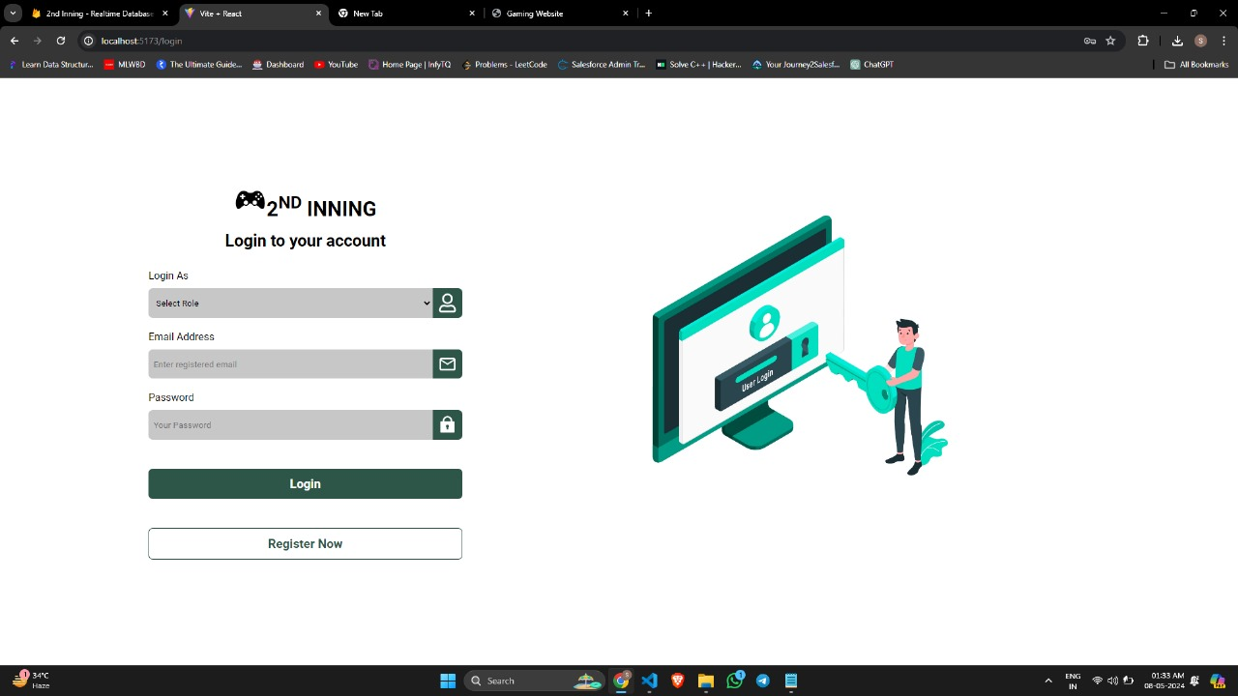

Slide 14
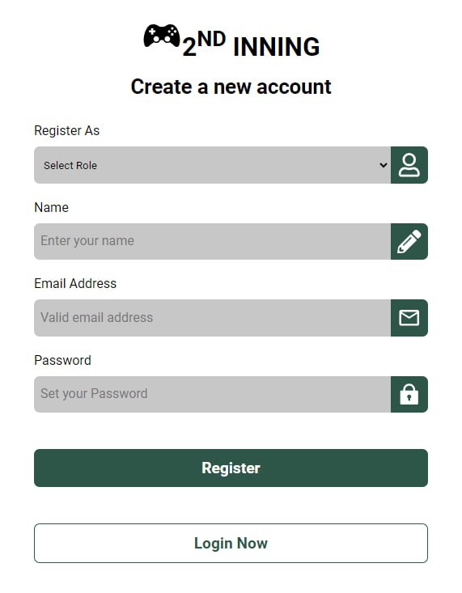

Slide 15
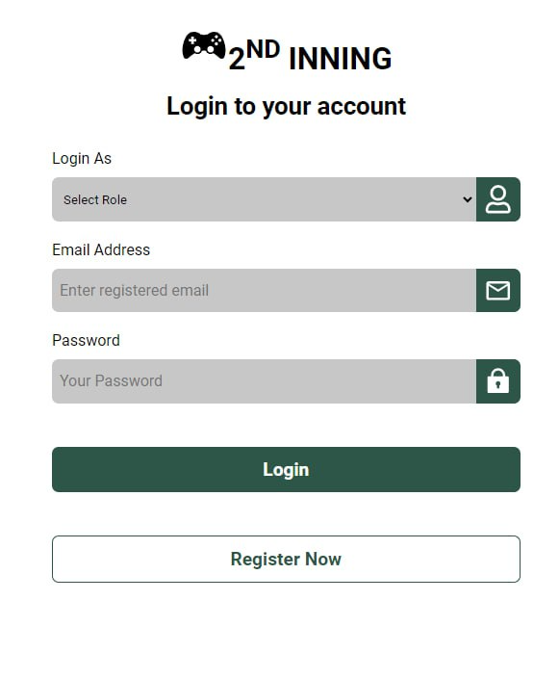

Slide 16
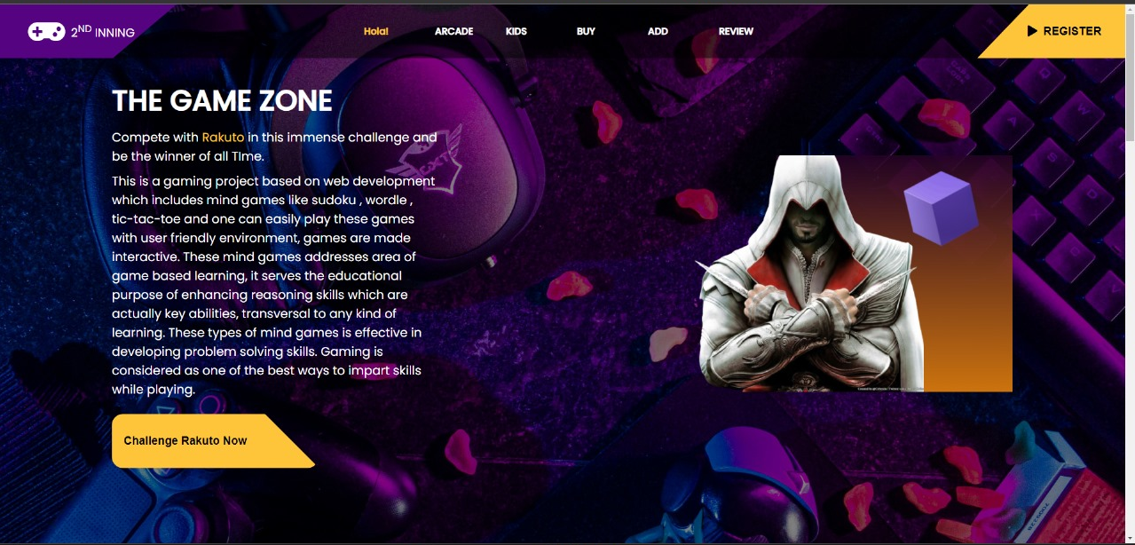

Slide 17
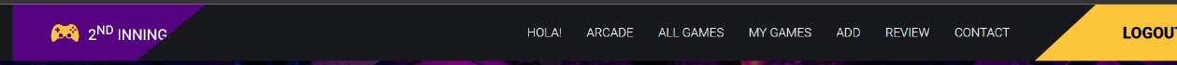
USER PANEL
ADMIN PANEL

Slide 18
Functionality Demonstration
Game Selection and Gameplay: Users can browse through a wide selection of games and choose their preferred ones to play. Gameplay mechanics are intuitive and user-friendly, providing an enjoyable gaming experience.
User Profile Management: Users can view and update their profile information, including personal details and profile picture. Profile management features ensure users have control over their account settings and preferences.
New Game Request Submission: Users can submit requests for new games by filling out a simple form, providing details such as the game title and description. Game request submissions are processed by the admin for review and consideration. Game Review Submission and Reading: Users can write and submit reviews for games they have played, sharing their opinions and ratings with the community.

Slide 19
Testing and evaluation
Description of the Testing Process:
Comprehensive Testing Strategy: 2nd Inning underwent rigorous testing at various stages of development to ensure functionality, usability, and reliability.
Testing Types: A combination of manual and automated testing approaches was employed to assess different aspects of the platform.

Slide 20
Types of Testing Performed
1. Functional Testing - Feature Validation: Testing individual features and functionalities to verify that they perform as intended. - User Experience Testing: Assessing the overall user experience, including navigation, interaction, and responsiveness.
2. Performance Testing - Load Testing: Simulating high user loads to evaluate the platform's performance under stress and ensure scalability. - Response Time Testing: Measuring response times for different actions and optimizing performance for optimal user experience.
3. Security Testing - Vulnerability Assessment: Identifying and addressing potential security vulnerabilities, such as SQL injection and cross-site scripting (XSS). - Data Privacy Testing: Ensuring compliance with data privacy regulations and safeguarding user data against unauthorized access.

Slide 21
Testing Results
Functional Testing: All key features and functionalities were tested and verified to meet requirements, with any identified issues promptly addressed.
Performance Testing: The platform demonstrated robust performance and scalability, with response times well within acceptable limits even under high user loads.
Security Testing: No major security vulnerabilities were identified, and appropriate measures were implemented to protect user data and ensure privacy.
Compatibility Testing: 2nd Inning was found to be compatible with a wide range of web browsers and devices, ensuring a consistent user experience across different platforms.

Slide 22
Result and analysis
Presentation of Project Results - Successful Launch: 2nd Inning was successfully launched, providing a comprehensive platform for rejuvenating cognitive abilities in elderly individuals through engaging mind games and activities. - Positive User Feedback: Initial feedback from users has been overwhelmingly positive, with many expressing appreciation for the platform's ease of use and engaging content. Performance Metrics - User Engagement: Metrics such as user registrations, game plays, and reviews submitted provide insights into user engagement and interaction with the platform. - Response Times: Performance metrics, including response times for key actions and transactions, help evaluate the platform's responsiveness and user experience. Analysis of Results in Comparison to Expectations - User Engagement: The platform has exceeded expectations in terms of user engagement, with a steady increase in user registrations and active participation in games and community interactions. - Performance: Response times for critical actions have met or exceeded expectations, indicating a smooth and responsive user experience even under high user loads.

Slide 23
Future work
Potential Areas for Future Improvements 1. Content Expansion: Continuously adding new games and activities to the platform to keep users engaged and provide a diverse range of cognitive exercises. 2. Personalization Features: Implementing more robust personalization features to tailor the user experience based on individual preferences, cognitive goals, and performance metrics. 3. Community Building: Enhancing community features such as forums, chat rooms, and user-generated content sharing to foster a sense of belonging and social interaction among users. 4. Accessibility Enhancements: Improving accessibility features to ensure the platform is inclusive and accessible to users with disabilities or special needs. 5. Data Analytics and Insights: Leveraging data analytics techniques to gain deeper insights into user behavior, preferences, and engagement patterns, and using these insights to optimize content and features.

Slide 24
Suggestions for Further Research or Development 1. Longitudinal Studies: Conducting longitudinal studies to assess the long-term effects of using the platform on cognitive health outcomes and quality of life in elderly populations. 2. Gamification Techniques: Exploring advanced gamification techniques and strategies to enhance user motivation, engagement, and adherence to cognitive training programs. 3. Collaborative Partnerships: Forming partnerships with healthcare providers, academic institutions, and research organizations to conduct collaborative research and validate the efficacy of the platform in clinical settings. 4. Technology Integration: Integrating emerging technologies such as virtual reality (VR) and augmented reality (AR) to create immersive and engaging cognitive training experiences. 5. Global Reach: Expanding the platform's reach to serve a broader audience of elderly individuals worldwide, including those from diverse cultural backgrounds and language preferences.

Slide 25
Conclusion
Summary of Project Accomplishments 1. Successful Launch: 2nd Inning has been successfully launched as an interactive platform dedicated to rejuvenating cognitive abilities in elderly individuals. 2. Positive User Feedback: Initial feedback from users has been overwhelmingly positive, highlighting the platform's ease of use, engaging content, and positive impact on cognitive health.
Key Takeaways 1. User-Centric Design: Prioritizing user needs and preferences is crucial for creating a successful and engaging platform. 2. Continuous Improvement: Iterative development and continuous feedback loops are essential for refining features and enhancing the user experience over time. 3. Collaborative Approach: Collaboration among multidisciplinary teams, including developers, designers, and domain experts, is key to project success and innovation.

Slide 26
Lessons Learned
1. Importance of Testing: Rigorous testing at various stages of development is essential for identifying and addressing issues early, ensuring a robust and reliable platform. 2. Adaptability and Flexibility: Being adaptable and flexible in response to user feedback and changing requirements is critical for meeting user needs and staying competitive in the market. 3. User Engagement Strategies: Implementing effective user engagement strategies, such as gamification and community-building features, is crucial for promoting sustained user participation and retention.

Slide 27
NAMASKARAM!

